Slide 1

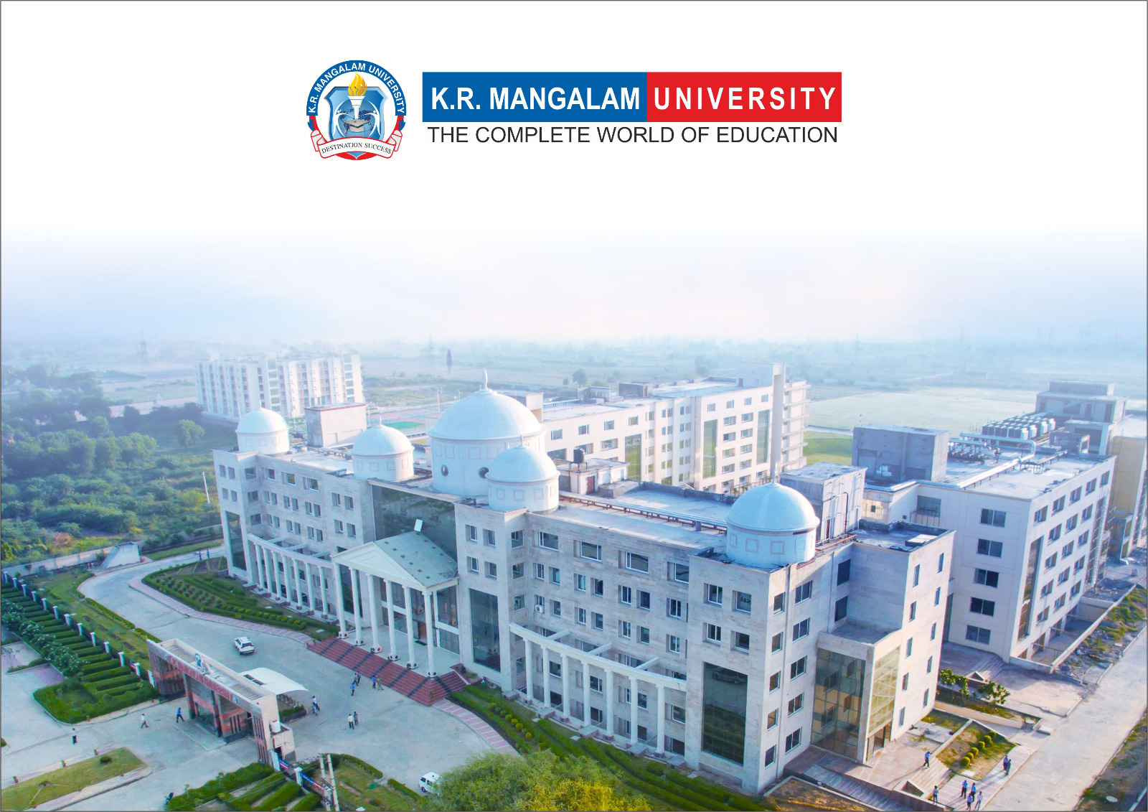
Course Code: ETCCCH104
Course Name: Engineering Chemistry
Program: B.Tech
Dr Deepak Yadav
Assistant Professor, Department of Chemistry
School of Basic and Applied Sciences
K.R. Mangalam University
Sohna Road, Gurugram

Slide 2
Basic concepts of polymer, Types of polymers

Slide 3
Session Outcomes
Understand the basic concepts of polymers.
Differentiate between types of polymers based on origin, structure, and polymerization.
Explain the difference between thermoplastic and thermosetting plastics.
Apply knowledge through examples and MCQs.

Slide 4
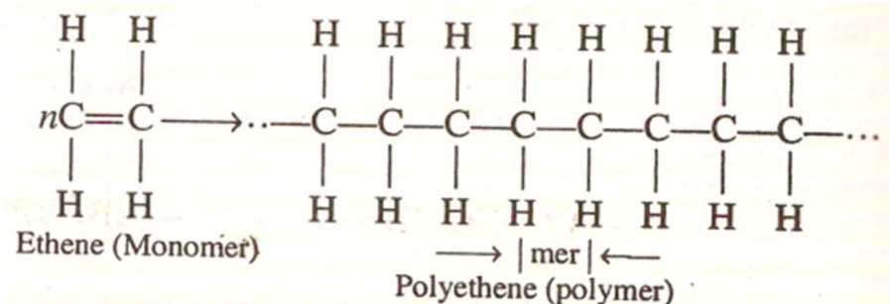
Introduction
A polymer is a large molecule of high molecular weight obtained by the chemical interaction of many small molecules of low molecular weight i.e. monomers.
The process of manufacture of a polymer is called the polymerization.
Polymer = poly means ‘many’ + mer means ‘units’.
Monomer is the molecule that forms the basic unit for Polymer. e.g., Propene, Styrene, Vinyl chloride etc.

Slide 5
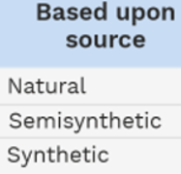
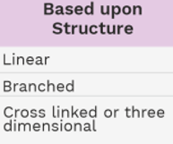
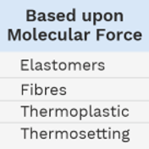
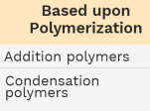
Classification of polymers

Slide 6
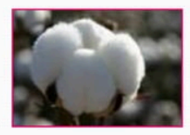
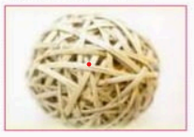
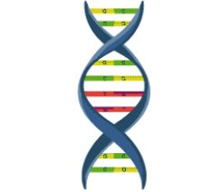
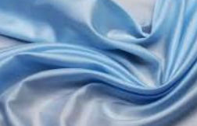
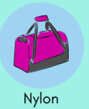
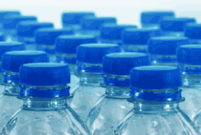
Classification Based upon source :
1. Natural polymers:- Polymers which are found in nature.
eg. Starch, cellulose and natural rubber, Silk, Proteins, DNA, RNA
2. Semisynthetic polymers:- It is obtained from naturally occurring polymers by chemical treatment. Most of the semisynthetic polymers are prepared from cellulose.
eg. cellulose acetate, cellulose nitrate, cellulose xanthate and rayon.
3. Synthetic polymers:- Man maid polymers are known as synthetic polymer. eg. PVC, polyethylene, polystyrene, nylon-6, nylon-6,6; nylon-6,10; terylene, synthetic rubbers etc.

Slide 7

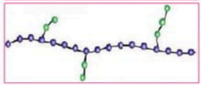
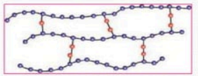
Classification Based upon structure :
1. Linear polymers:- Monomers are joined together to form long straight chains. The various linear polymeric chains are stacked over one another to give a well packed structure close packed in nature, having high densities, high melting point and high tensile (pulling) strength.
e.g. cellulose, silk, nylon, terylene etc.
2. Branched chain polymers:- Polymers in which the monomeric units
constitute a branched chain. These have lower melting point low densities and tensile strength as compared to linear polymers.
e.g. amylopectin, glycogen, polyethylene.
3. Cross linked or Three-Dimensional network polymers:- When linear polymeric chains are joined together to form a three dimensional network structure. These polymers are hard, rigid and brittle. Cross linked polymers are always condensation polymers. e.g. Resins.

Slide 8
Classification Based upon molecular force :
1. Elastomers:- Polymers in which the intermolecular forces of attraction between the polymer chains are the weakest (weak van der Waals forces of attraction) these polymers consist of randomly coiled molecular chains of irregular shape having a few cross links.
e.g. natural rubber, Buna-S, Buna-N etc.
2. Fibers:- Those polymers in which the intermolecular forces of attraction are the strongest are called fibers. These polymers held together by H-bonding or dipole-dipole interaction. Fibers have high tensile strength, least elasticity having high melting point and low solubility.
3. Thermoplastics:- In thermoplastics, intermolecular forces of attraction are in between those of elastomers and fibers. Thermoplastics become soft and viscous on heating and rigid on cooling.
Examples are polythene, nylon-6, nylon-6,6.

Slide 9
4. Thermosetting polymers:- These polymers have low molecular masses and are semi-fluid substances. These polymers are hard and infusible.
Examples are melamine-formaldehyde, Bakelite (phenol-formaldehyde).
Classification Based upon polymerisation:
1. Addition polymerization:- A polymerization reaction in which
monomers containing one or more double bonds are linked to each other without the elimination of any by products, usually in the presence of initiators is called addition polymerization.
e.g. Formation of polythene.
2. Condensation polymerization:- That polymerization process in which linking together different monomers accompanied by the elimination of small molecules like H₂O, HCl, and NH_{3.}
e.g. Formation of Nylon6,6.

Slide 10
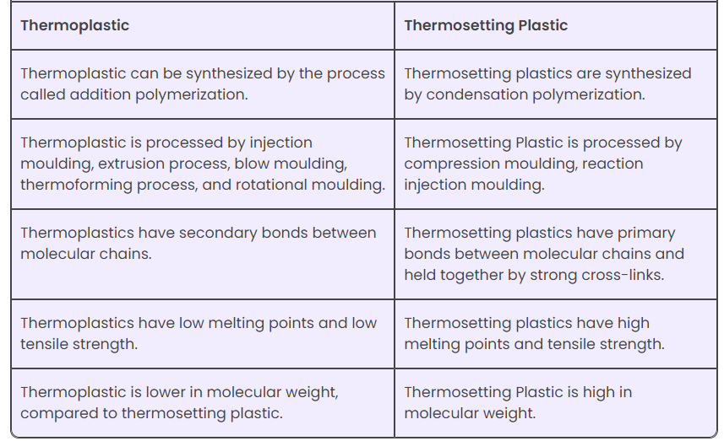
Difference Between Thermoplastic and Thermosetting Plastic

Slide 11
Takeaway of the Session
Polymers are macromolecules formed by monomers.
Classified based on origin, structure, and polymerization.
Thermoplastics: reusable, soften on heating.
Thermosetting plastics: rigid, heat-resistant, non-recyclable.

Slide 12
Q1. Polymers are made up of repeating units called: a) Crystals b) Monomers c) Fibers d) Atoms
Q2. Which of the following is a thermoplastic? a) Bakelite b) Melamine c) PVC d) Epoxy resin
Q3. Which type of polymerization involves the elimination of a small molecule like water? a) Addition b) Condensation c) Substitution d) Chain-growth
Q4. Bakelite is an example of: a) Linear polymer b) Thermoplastic c) Thermosetting polymer d) Semi-synthetic polymer

Slide 13
Thank You

